Slide 1

Transportation Services

Slide 2
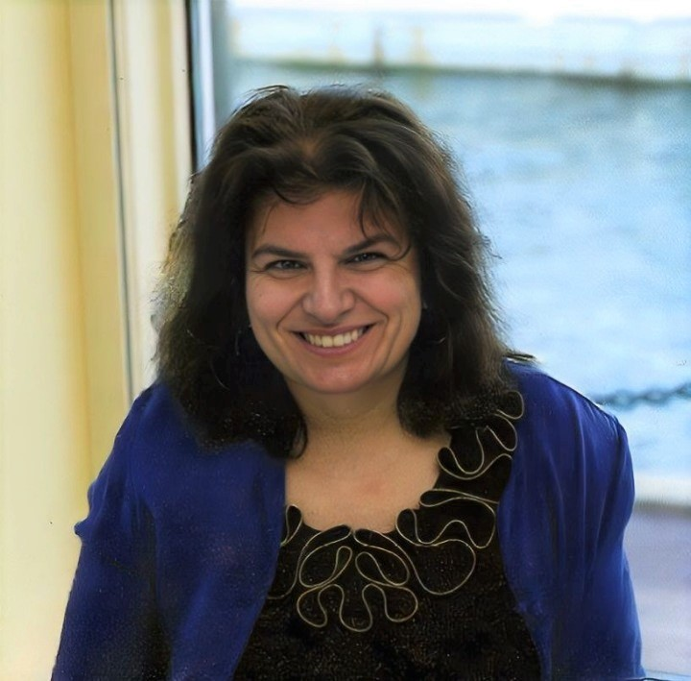

SERVICES OF THE REGIONAL MOBILITY MANAGER
Donna M. Marceau
Nashua Regional
Planning Commision
30 Temple Street, Suite 310
Nashua, NH 03060
donnam@nashuarpc.org
603 417 6571

Slide 3
Brand New Service:
If you have clients who have suffered from the Opioid Crisis, please contact me if they need help with transportation.

Slide 4

Old Bikes… New Life
Free Bike Program Procedures of 2026
gatecitybikecoop@gmail.com 603 759-9056 http://gatecitybikecoop.org

Slide 5
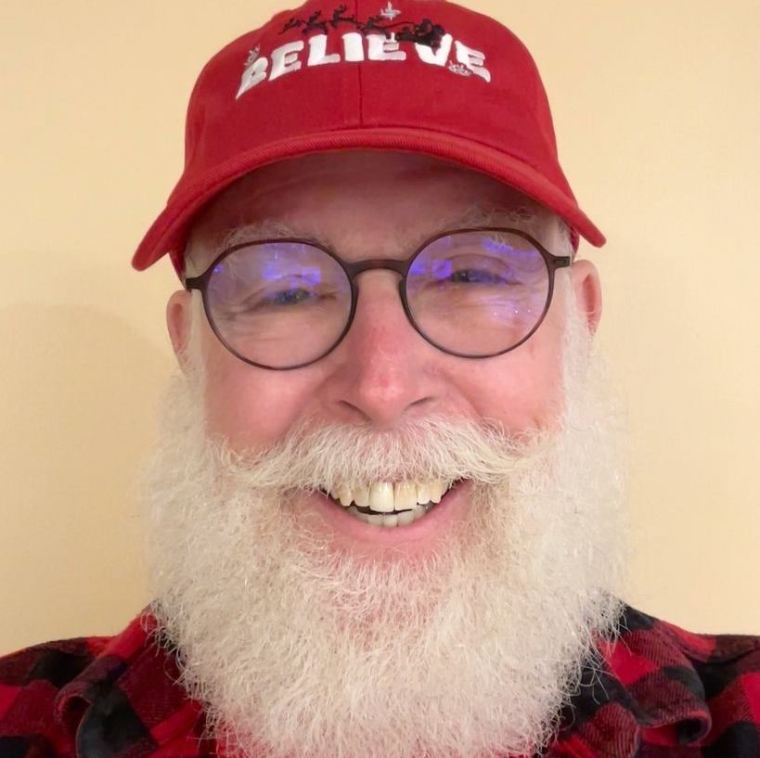
Gate City Bike Coop was established about 10 years ago, by the late John Burkitt to take excess bikes and refurbish them and give them away to low income individuals.

Slide 6
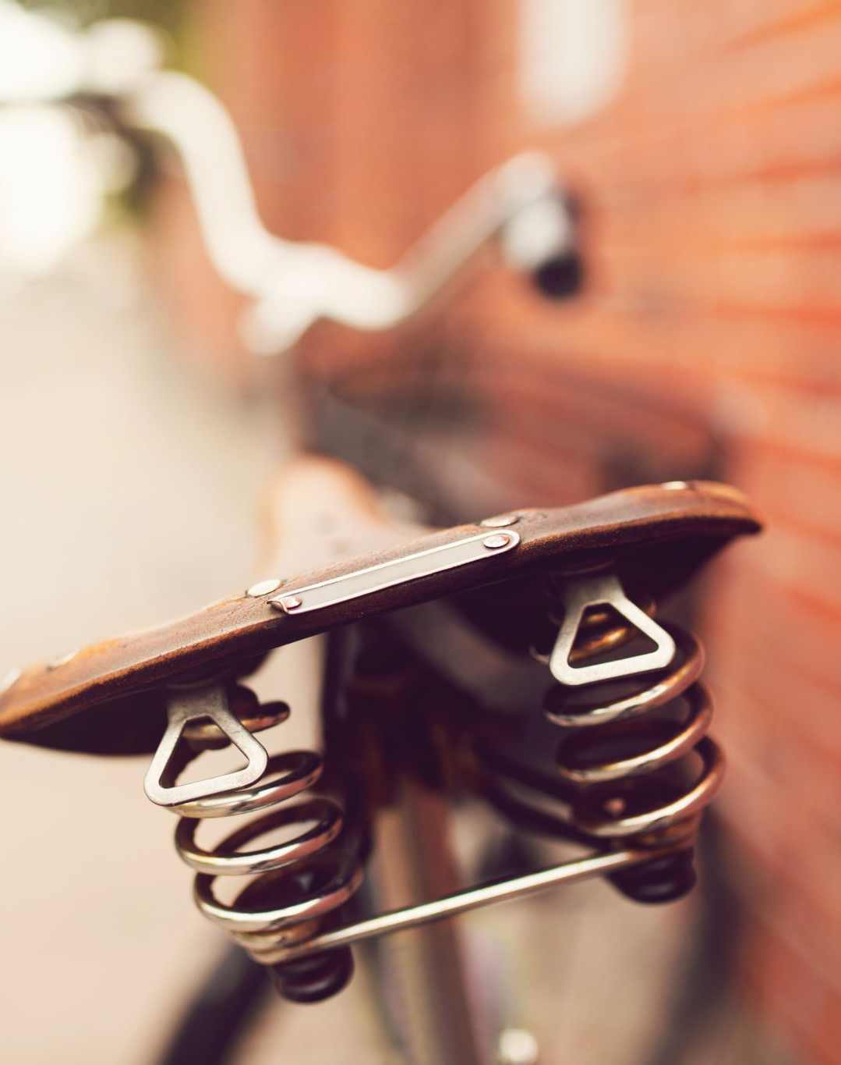
The program serves two purposes:
1. Gives no cost transportation (bikes) to low-income people;
2. Recycles bikes!

Slide 7
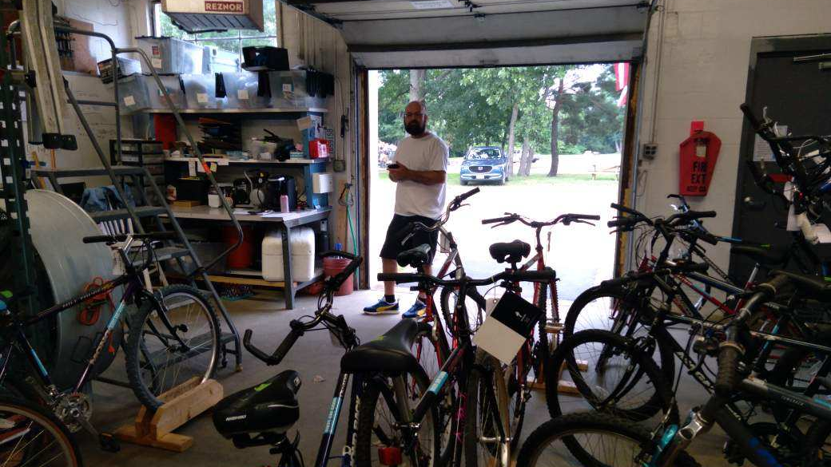
Maximizing Getting People on Bikes
Each year, the GCBC gives away around 500 bikes per year.
  Demand remains very high.
Last year, with the appointment system we had a significant problem with no-shows last year.
  This is unfair to others who could have gotten a bike sooner.
  It was discouraging to our volunteers.

Slide 8
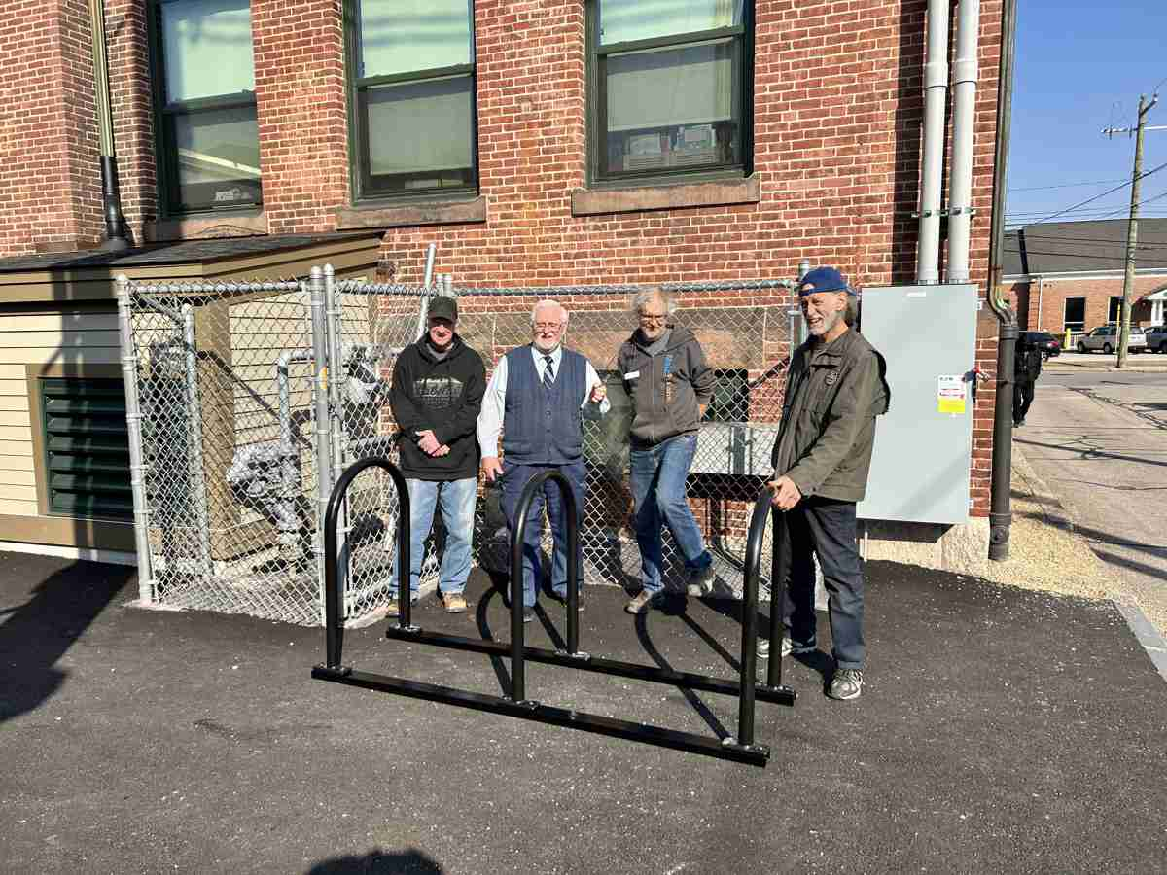
Some adjustments this year:
  1. Not booking as far in advance.
  2. Accepting a limited number of walk-ins.

Slide 9
Riders Need a Voucher - Procedures
We accept vouchers from all agencies, from school counselors, churches.
A single individual needs a voucher, but one voucher can cover multiple family members.
The voucher form is on our website.
  HTTP://gatecitybikecoop.org/voucher
Print and fill out the voucher and give it to the client.
  You can also email us a scanned copy of the filled-out voucher. That is especially useful if you believe the client is likely to lose or forget to bring the voucher, but we prefer to have the client bring it to us.

Slide 10
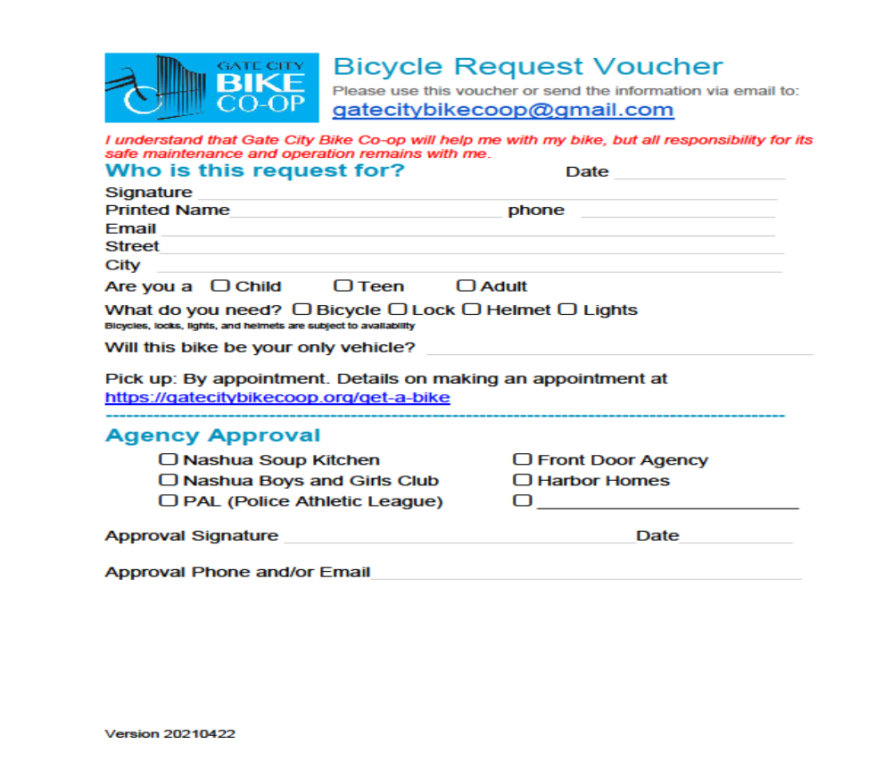

Slide 11
New for 2026: Two Ways to Get a Free Bike
Scheduled Appointments
Only guaranteed way to get a bike.
Schedule via the GCBC website.
  http://gatecitybikecoop/get-a-bike
Openings show up 3 weekends in advance.
Walk-Ins
Up to 5 walk-ins on any given Monday.
  The actual number will depend on how many suitable bikes we have on hand.
Come at 2:30 PM and “Take a Number”.
  Expect to wait. People with appointments will be served first.
You may or may not get a bike.

Slide 12
Monday Is Still the GCBC Distribution Day
Scheduled Appointments and Walk-Ins are both on Monday Afternoons.
  Open at 2:30 PM at 17B Airport Road, Nashua, NH
If a client cannot possibly make it on Mondays…
  . please call or email to make an alternate arrangement.
Note: Most Monday holidays are excluded from our scheduling app, and we will not take walk-ins on those days.

Slide 13
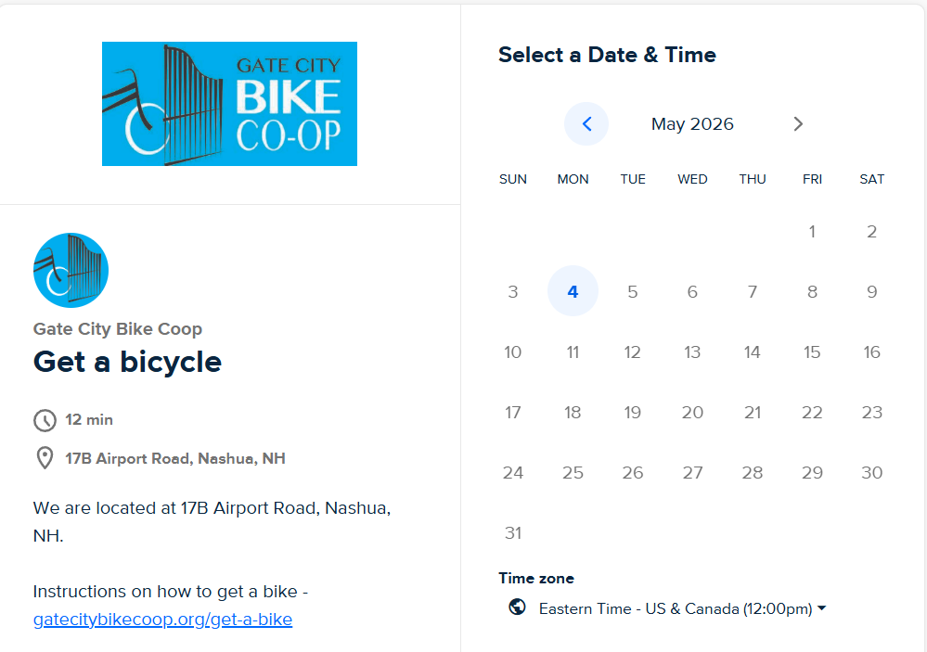
How The Scheduler Works
The link to our scheduler app is on our website at http://gatecitybikecoop/get-a-bike
Mondays with available slots show up as blue clickable links.
If no blue Mondays show in the current or next month, we are fully booked.
New appointment slots go live in the app on Friday evenings.

Slide 14
Helping a Client With Scheduling
Friday night or Saturday is the best time to use the website to schedule an appointment.
If you fill in the appointment form for a client, please list their phone number and email so that they will receive the reminders.
If a client does not have a phone or email, or is in danger of losing access, then go ahead and list your own contact info.
But also, please do your best to remind the client of their appointment day and time at the end of the prior week.

Slide 15

Families and Children, part 1
Each adult receiving a bike needs their own appointment.
Adults can not pick up bikes for their children.
The child must come to 17B Airport Rd., accompanied by an adult.
Let us know that children are coming in advance.
They must have an appointment. They cannot come as walk-ins.
A family with multiple children receiving bikes can make a single appointment for them.
After we see the appointment in our system, we may call to move the appointment time.
If adults are also receiving bikes, that is a separate appointment.
Fill in all children’s names, ages, and heights in the “Special Requirements” field in our appointment app.

Slide 16
Families and Children, part 2
Children may need to choose a bike and then come back to pick it up a few days later.
We want kids to get the bike that they will be most happy with, but we can only have a few children’s bikes in ready-to-go condition at any one time. Some of the bikes that we show them have not yet been reconditioned and safety-checked by our mechanics.
It is very important to prepare children for this possibility in advance to avoid disappointment.
A family with multiple children receiving bikes can make a single appointment for them.
After we see the appointment in our system, we may call to move the appointment time so that our volunteers’ full attention can be on the kids.
If adults in the family are also receiving bikes, that is a separate appointment.
Fill in all children’s names, ages, and heights in the “Special Requirements” field in our appointment app.

Slide 17

For Urgent Situations
True urgent situations must be rare.
  Please reach out to us if a client needs special consideration.
  If the client reaches out to us, we will ask them to have you contact us.
Urgent situations include..,
  Imminent loss of job or job opportunity.
  Current inability to get to important appointments. I.e., health, mental health, recovery…
If a client comes as a Monday walk-in, and there are 5 or more people ahead of them, we cannot take the urgency of their situation into account.

Slide 18
Things to Tell Your Client, Part 1
Use our on-line scheduler. Calling us is not the way to get on our schedule.
If there are no days to click on in our scheduler, that means we are fully-booked. Be patient. Slots will open. Consider coming to us as a walk-in, but remember that we limit the number each week.
It is okay to schedule an appointment and still walk-in a week earlier to try and get a bike sooner.
If they get a bike this way, they should be sure to tell us to cancel their appointment and make their reserved slot available to someone else.

Slide 19
Things to Tell Your Client, Part 2
If your client cannot make it to their scheduled appointment. They do need to call or email us. gatecitybikecoop@gmail.com
The client must pick up the bike themselves. They cannot send a friend or family member to pick up their bike.
Directions to the GCBC are on our website http://gatecitybikecoop.org/directions

Slide 20
Brand New Service:
If you have clients who have suffered from the Opioid Crisis, please contact me if they need help with transportation.

Slide 21


